Slide 1

The Price of Zero: Public Sentiment on Amazon's 2018 Federal Tax Avoidance
Ali Al-Rikabi 10166070
Daniela Mañozca Cruz 30262558
David Fakolujo 30273636
Luisa Alejandra Sierra Guerra 30261956
Notes:
Our project for DATA604 is determining factors of life expectancy across continents and countries.

Slide 2

Table of Contents
History, Scandal & Relevance
Objectives
Guiding Questions
Analysis Roadmap
Visualizations and Explanations
Key Findings
Ethics and Recommendations
Notes:
Founded in a garage in 1994 as “Cadabra,” Amazon began as an online bookstore delivering across the U.S. and 45 countries. It began as a simple online bookstore, but unlike traditional shops limited by shelves and square footage, Amazon promised every book, everywhere, powered by the internet. Just one year later, it became Amazon Inc, aiming to become the world’s largest bookstore by operating fully online — avoiding the limits of physical retail.
Amazon emerged during the dot-com boom, and quickly evolved beyond books. By 1999, it introduced third-party sellers, and in 2005, launched Amazon Prime, revolutionizing customer loyalty with fast, free shipping. As e-commerce — the buying and selling of goods online — took off globally, Amazon helped define it. With over 200 million Prime members and 2.14 billion online shoppers worldwide, Amazon now leads the sector, setting the standard for digital retail, innovation, and customer experience.Through bold expansion and constant adaptation, Amazon hasn't just followed the evolution of e-commerce — it has shaped it

Slide 3





History
Amazon began as an online bookstore delivering across the U.S. and 45 countries.
Amazon emerged during the dot-com boom and quickly evolved beyond books.
Founded in a garage in 1994 as “Cadabra”.
By 1999, it introduced third-party sellers
As e-commerce took off globally, Amazon helped define it. With over 200 million Prime members and 2.14 billion online shoppers worldwide, Amazon now leads the sector, setting the standard for digital retail, innovation, and customer experience
1
Notes:
Founded in a garage in 1994 as “Cadabra,” Amazon began as an online bookstore delivering across the U.S. and 45 countries. It began as a simple online bookstore, but unlike traditional shops limited by shelves and square footage, Amazon promised every book, everywhere, powered by the internet. Just one year later, it became Amazon Inc, aiming to become the world’s largest bookstore by operating fully online — avoiding the limits of physical retail.
Amazon emerged during the dot-com boom, and quickly evolved beyond books. By 1999, it introduced third-party sellers, and in 2005, launched Amazon Prime, revolutionizing customer loyalty with fast, free shipping. As e-commerce — the buying and selling of goods online — took off globally, Amazon helped define it. With over 200 million Prime members and 2.14 billion online shoppers worldwide, Amazon now leads the sector, setting the standard for digital retail, innovation, and customer experience.Through bold expansion and constant adaptation, Amazon hasn't just followed the evolution of e-commerce — it has shaped it

Slide 4

The 2018 Amazon Tax Scandal
+$100 Billion
Since 2014, Amazon annual revenue has exceeded $100 billion, reaching $637 billion in 2024. Naturally, many assume that such large corporations pay substantial amounts in taxes.
Accounting strategy
Tax liability isn’t based on revenue alone. Depending on a company’s financial history and accounting strategy, businesses can carry forward past losses and apply them to reduce taxable income in future years.
$232.9 Billion
In 2018, Amazon used this mechanism, along with federal tax policy changes, to reduce its federal income tax liability to zero, despite generating over $232.9 billion in revenue that year.
$11.2 Billion
In 2018, Amazon reported $11.2 billion in U.S. profits—yet paid zero dollars in federal income tax. This sparked widespread public outrage and media scrutiny.
$129 Million
Despite being one of the most profitable companies in the world, Amazon not only avoided paying federal income tax but received a $129 million tax rebate.
2
Notes:
+Since 2014, Amazon annual revenue has exceeded $100 billion, reaching $637 billion in 2024. Naturally, many assume that such large corporations pay substantial amounts in taxes.
+However, Tax liability isn’t based on revenue alone. Depending on a company’s financial history and accounting strategy, businesses can carry forward past losses and apply them to reduce taxable income in future years.
+In 2018, Amazon used this mechanism, along with federal tax policy changes introduced under the Trump administration, to reduce its federal income tax liability to zero, despite generating over $232.9 billion in revenue that year. The scandal ignited debates on corporate accountability and called into question whether the wealthiest companies are contributing their fair share to society.
+In 2018, Amazon reported $11.2 billion in U.S. profits—yet paid zero dollars in federal income tax. This sparked widespread public outrage and media scrutiny, raising serious concerns about: Corporate tax avoidance Loopholes in the U.S. tax code Fairness in the tax system
+Amazon not only avoided paying federal income tax but received a $129 million tax Despite being one of the most profitable companies in the world, rebate.

Slide 5





Objectives
Identify the primary topics associated with Amazon’s tax scandal.
Evaluate the overall sentiment polarity and subjectivity of the dataset to assess the general tone of public opinion.
Explore which categories of viewer comments generated the highest engagement, based on the volume of responses per topic.
Determine how specific categories of comments contribute to shaping consumer attitudes toward Amazon
Map the structure and interconnections among key discussion topics to uncover the dynamics behind audience sentiment.
4

Slide 6
Guiding Questions
What are the primary topics discussed in the YouTube comments related to Amazon's $0 tax payment in 2018?
What is the overall public sentiment toward Amazon's $0 federal tax payment in 2018? Positive, negative, neutral?.
Which three comment categories or themes generated the highest levels of engagement (replies frequency)?
Do certain types of comments appear to influence consumer perception or attitudes toward Amazon? If so, how?
Are there observable connections or patterns among the most frequently discussed topics?
5

Slide 7






Analysis Roadmap
Data extraction from YouTube
General topics Classification using IA
Data Cleaning
Exploratory Data Analysis
Word Frequency Analysis
Compute Polarity and Subjectivity Score
Define Goals and Guiding Questions
Categorize scores and Plot – Sentiment Analysis
Correlation Analysis for topics
Estimate Degree of centrality and Betweenness
Asses different models performance
Main topics definition
Assisted Classification using IA
Answer guiding questions
Discuss recommendations based on the results
Data Manipulation
Pandas
Numpy
Datetime
Text Preprocessing and NLP
String
Re
Nltk
TextBlob
Visualization
Matplotlib
Seaborn
Worldcloud
ML and Modeling
Scipy
Sklearn
6

Slide 8
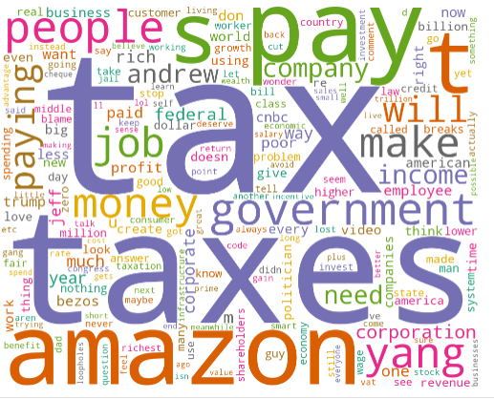
What are the primary topics discussed in the YouTube comments related to Amazon's $0 tax payment in 2018?
High frequency of Tax-Related Terms: The most prominent words are “tax”, “taxes” ,“pay”.
Strong Focus on Amazon: The word “Amazon” appears centrally, reinforcing that public discourse was intensely centered on the company’s actions.
Public Sentiment around Fairness: Words like “people”, “job”, “money”, and “corporation” suggest that commenters are drawing contrasts between everyday taxpayers and large corporations.
Political and System criticism: Mentions of “government”, “federal”, and “yang” indicate that the conversation extended into political territory.
Calls for action: Terms such as “need”, “make”, “change”, and “breaks” imply not just criticism, but a desire for change in tax policy or corporate responsibility.
7
Notes:
High Frequency of Tax-Related Terms
The most prominent words are “tax,” “taxes,” “pay,” and “government,” highlighting widespread public concern and frustration about Amazon’s federal tax avoidance.
Strong Focus on Amazon and Its Role
The word “Amazon” appears centrally, reinforcing that public discourse was intensely centered on the company’s actions and perceived accountability.
Public Sentiment Around Fairness
Words like “people,” “job,” “money,” and “corporation” suggest that commenters are drawing contrasts between everyday taxpayers and large corporations, pointing to a perceived imbalance in the system.
Political and Systemic Criticism
Mentions of “government,” “federal,” and “yang” indicate that the conversation extended into political territory, with viewers debating systemic reform and citing political figures like Andrew Yang who proposed alternative taxation models.
Calls for Action or Reform
Terms such as “need,” “make,” “change,” and “breaks” imply not just criticism, but a desire for change in tax policy or corporate responsibility.

Slide 9
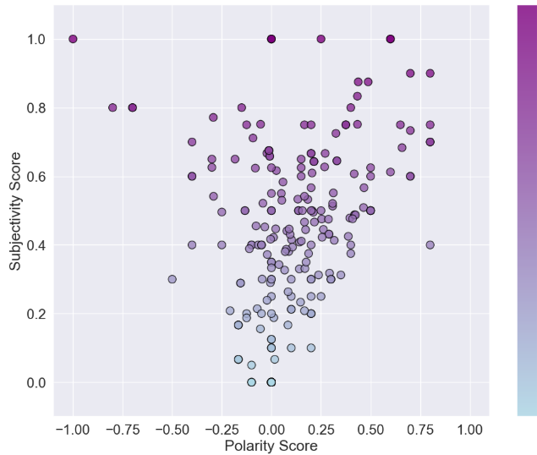
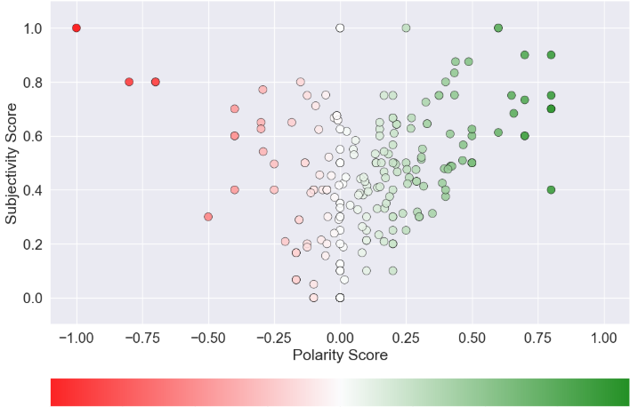
What is the overall public sentiment toward Amazon's $0 federal tax payment in 2018? positive, negative, neutral?
Sentiment Analysis by Polarity
Sentiment Analysis by Subjectivity
8

Slide 10
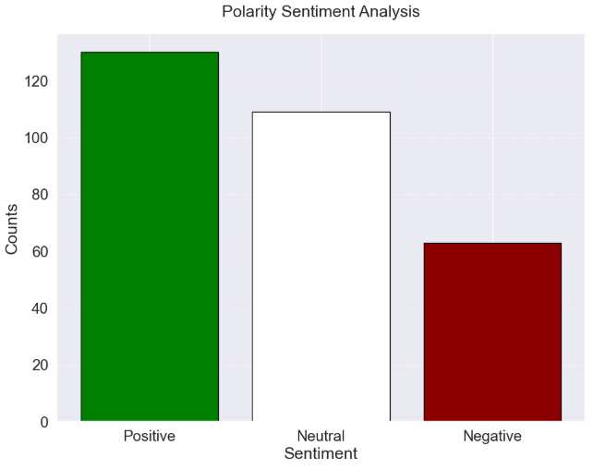
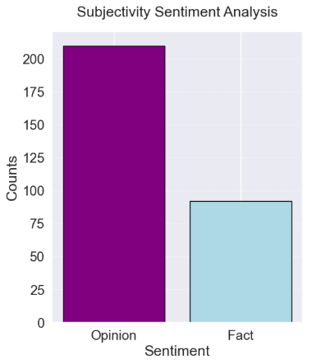
What is the overall public sentiment toward Amazon's $0 federal tax payment in 2018? positive, negative, neutral? (Cont.)
9

Slide 11
Which topics categories received the most replies, indicating higher audience engagement?
MAIN TOPICS
Constructive / Forward-Looking
Systemic or Political Critique
Emotional or Public Voice
Opinion on Corporate
External Context
Undefined
SUB - TOPICS
Reform for Proposal or Citizen Action
Criticism of The Tax System , Corruption and Lobbying
Sarcasm or Critical Humor, Moral or Ethical Outrage
Justification of the Corp. Model, General Instit. Distrust
International Comparison
Other
10

Slide 12
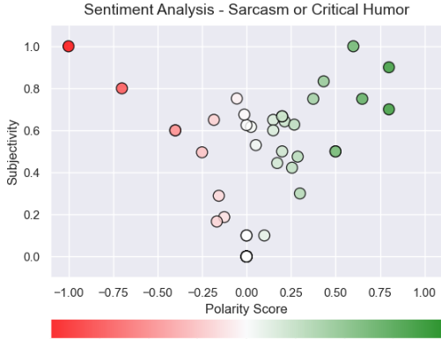
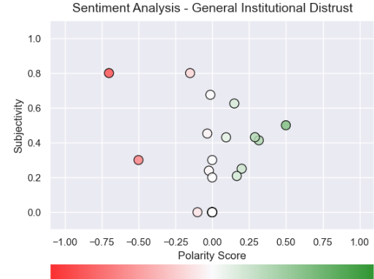
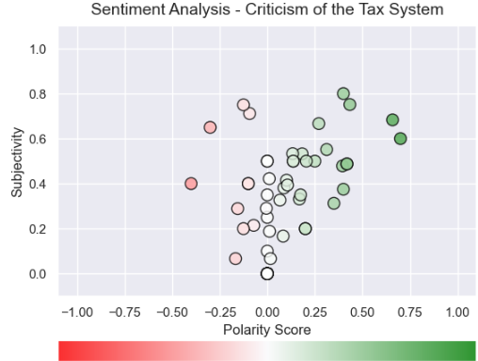
Do certain types of comments appear to influence consumer perception or attitudes toward Amazon?
Although the three plots presented correspond to topic categories with highest frequency of negative polarity scores, most comments shows neutral or slightly positive polarity, even in sarcastic or critical contexts. This likely reflects the algorithm’s inability to detect implied negativity when emotional tone is subtle or ironic.
11

Slide 13
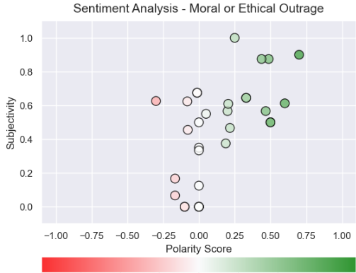
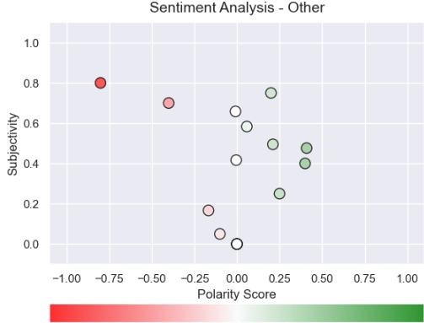
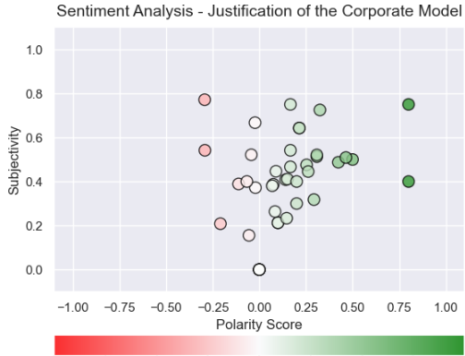
Do certain types of comments appear to influence consumer perception or attitudes toward Amazon? (Cont)
.
Comments labeled as "Moral or Ethical Outrage" appear overwhelmingly positive in polarity, contradicting the tone of critique seen in raw comments. This reinforces how emotionally neutral wording masks discontent, leading to misclassification.
12

Slide 14
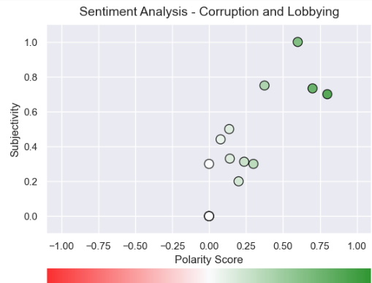
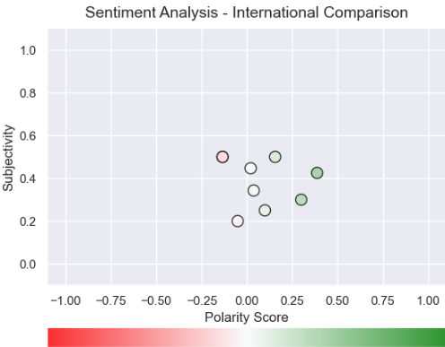
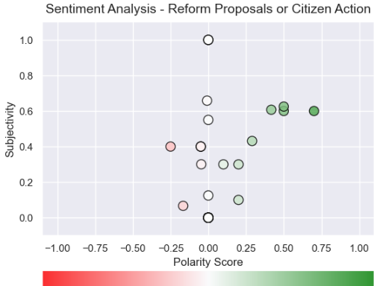
Do certain types of comments appear to influence consumer perception or attitudes toward Amazon? (Cont)
Topics such as "Corruption and Lobbying“, which naturally suggest disapproval, are misclassified as positive or neutral, as the word "corruption" is not treated as emotionally charged unless paired with explicit sentiment terms.
13
Notes:
Topics such as "Corruption and Lobbying“, which naturally suggest disapproval, are misclassified as positive or neutral, as the word "corruption" is not treated as emotionally charged unless paired with explicit sentiment terms. Reform-related comments show a clearer polarity spread, suggesting more direct emotional cues.

Slide 15
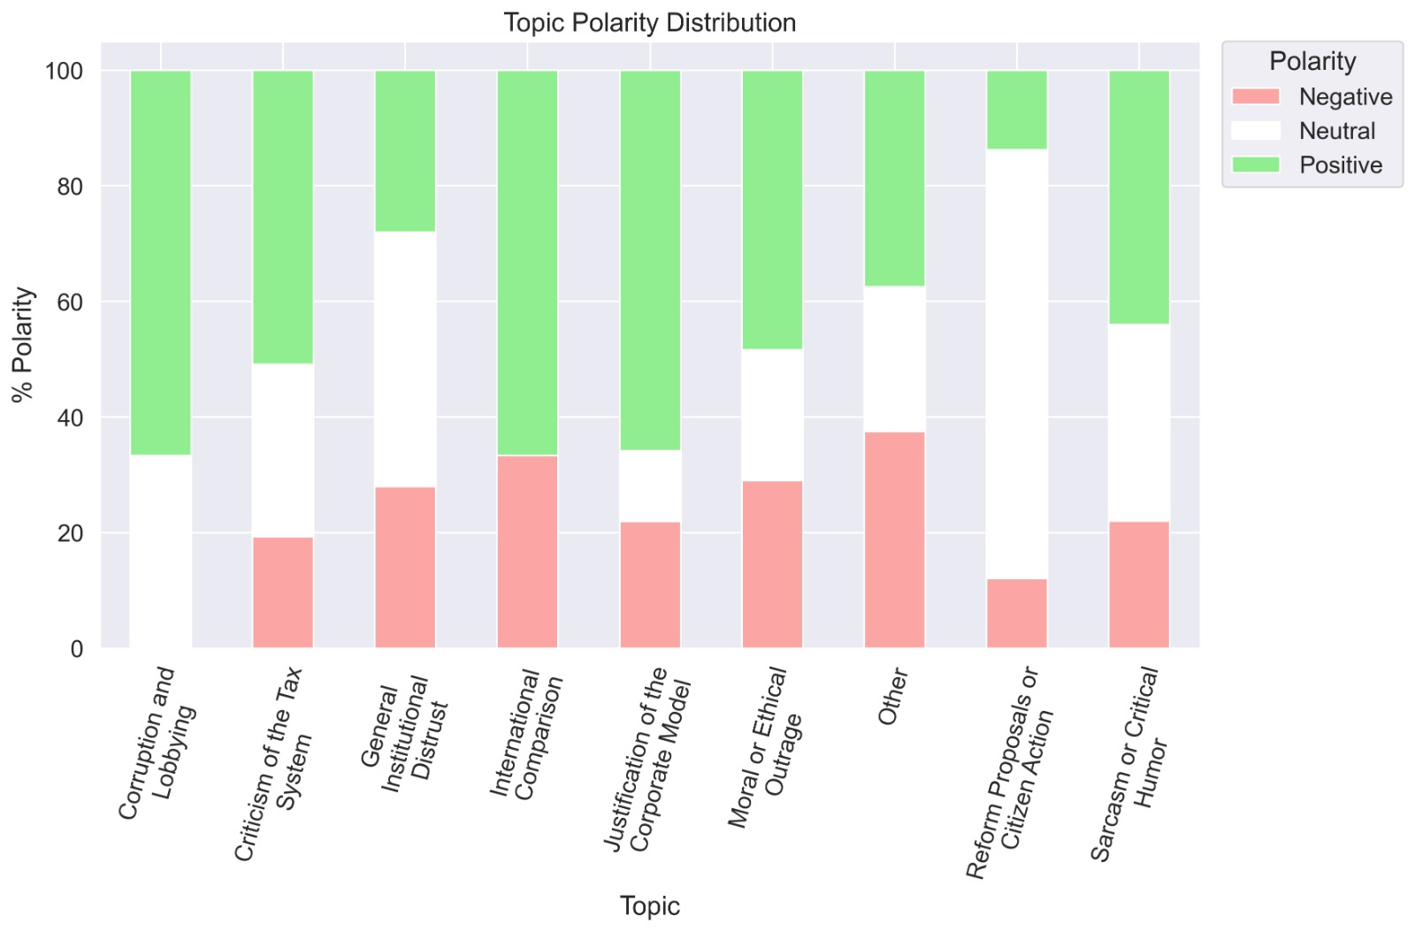
Do certain types of comments appear to influence consumer perception or attitudes toward Amazon? (Cont)
Most topics show high levels of “positive” polarity, even when their actual tone (“Corruption” or “Moral Outrage” comments) should lean negative.
“General Institutional Distrust” and “Other” have the highest share of negative polarity, suggesting stronger emotional reactions.
“Reform Proposals” and “Justification of the Corporate Model” skew strongly positive, likely because their wording leans more constructive or neutral.
Calls for action: Terms such as “need”, “make”, “change”, and “breaks” imply not just criticism, but a desire for change in tax policy or corporate responsibility.
14
Notes:
+ Most topics show high levels of “positive” polarity, even when their actual tone (e.g., in “Corruption” or “Moral Outrage”) should lean negative. This likely stems from misclassification due to the lack of explicit emotional words.
+“General Institutional Distrust” and “Other” have the highest share of negative polarity, suggesting stronger emotional reactions in these less structured or broadly critical comments.
+ “Reform Proposals” and “Justification of the Corporate Model” skew strongly positive, likely because their wording leans more constructive or neutral.
This chart reinforces that sentiment polarity alone may not reliably reflect consumer discontent, especially when negative opinions are delivered through factual or ironic language. Topics related to system critique may appear positive due to algorithmic limitations, not actual sentiment.

Slide 16
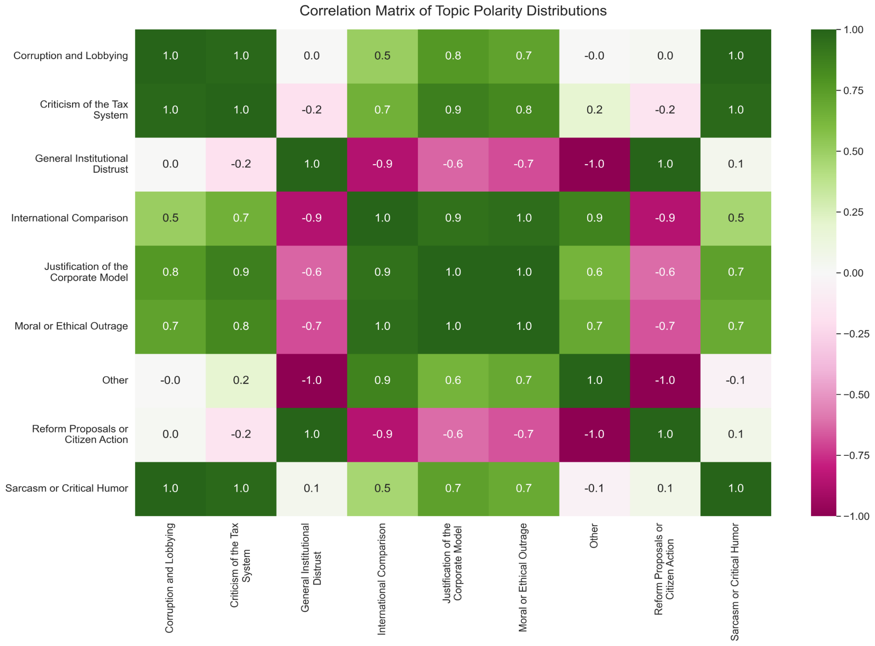
Are there observable connections or patterns among the most frequently discussed topics?
Strong positive correlations exist between Criticism of the Tax System, Sarcasm or Critical Humor, and Corruption and Lobbying.
General Institutional Distrust shows strong negative correlations with most topics (especially International Comparison and Other at -0.9 to -1.0),
Justification of the Corporate Model correlates well with many topics, suggesting it often co-occurs in conversations spanning different sentiment types.
This matrix reveals that while many topics share similar sentiment distributions, some stand apart, likely due to phrasing that conceals tone, confusing automated sentiment tools.
15
Notes:
+Strong positive correlations exist between: Criticism of the Tax System, Sarcasm or Critical Humor, and Corruption and Lobbying (all values ≈ 1.0). These topics are likely discussed with similar tones, suggesting a shared sentiment of critique or frustration.
+General Institutional Distrust shows strong negative correlations with most topics (especially International Comparison and Other at -0.9 to -1.0), indicating a distinct tone or framing, potentially more cynical or fact-driven and less emotionally expressive.
+Justification of the Corporate Model correlates well with many topics, suggesting it often co-occurs in conversations spanning different sentiment types. + Interpretation: This matrix reveals that while many topics share similar sentiment distributions, some (like Institutional Distrust) stand apart, likely due to phrasing that conceals tone, confusing automated sentiment tools. Strong topic clusters may also point to compound commentary (EXAMPLE: sarcastic remarks about both tax systems and corporate behavior).

Slide 17
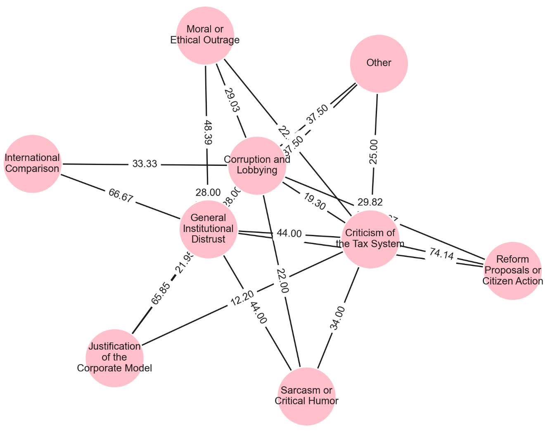
Are there observable connections or patterns among the most frequently discussed topics? (Cont)
Criticism of the Tax System is the most central node in the network, connected to the largest number of other topics.
Corruption and Lobbying is another high-betweenness topic, acting as a connector between polarizing or less-connected themes such as Moral Outrage, Institutional Distrust, and Other.
Topics like International Comparison and Justification of the Corporate Model appear more peripheral, suggesting they are part of more specialized or isolated comment threads rather than core discourse.
16
Notes:
+Criticism of the Tax System is the most central node in the network, connected to the largest number of other topics. Which means it serves as a bridge across themes, often co-occurring in conversations that touch multiple angles of the Amazon tax scandal.
+Corruption and Lobbying is another high-betweenness topic, acting as a connector between polarizing or less-connected themes such as Moral Outrage, Institutional Distrust, and Other. This reinforces its role as a recurring theme, even in different narrative tones (factual, sarcastic, outraged).
+Topics like International Comparison and Justification of the Corporate Model appear more peripheral, suggesting they are part of more specialized or isolated comment threads rather than core discourse. .
+This network visualization shows how certain topics anchor the public conversation, Criticism of the Tax System and Corruption and Lobbying act as thematic hubs, revealing where public sentiment overlaps and intensifies. These topics likely drive overall attitudes and narrative coherence in user reactions to Amazon’s tax behavior.

Slide 18
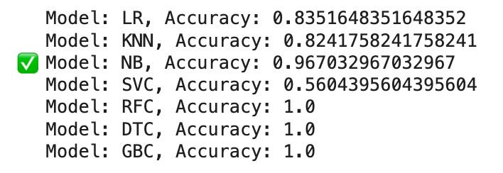
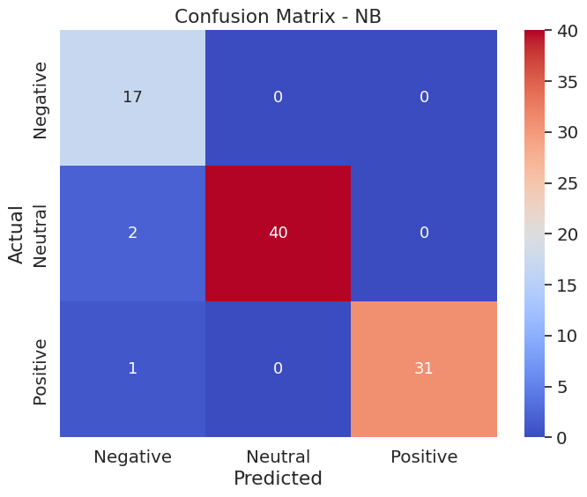
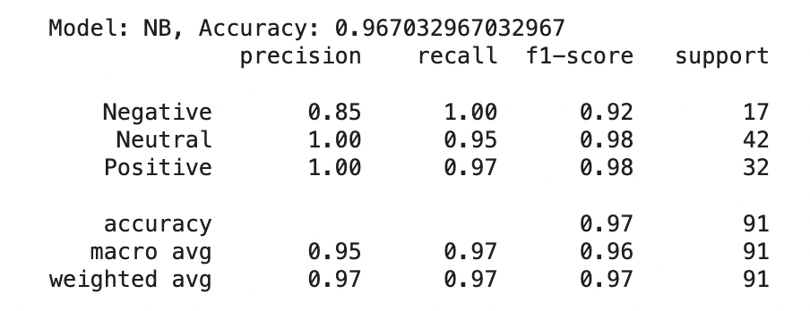
Key Findings – Predicting Polarity Analysis
A classification task was performed to predict sentiment polarity (Negative, Neutral, Positive) using Polarity, Subjectivity, and Topic as predictors.
Multiple classification models were tested, and Naive Bayes was selected as the preferred model due to its high accuracy and generalization without overfitting.
The Naive Bayes model was further evaluated using a classification report and confusion matrix, showing strong performance across precision, recall, and F1 score.
17

Slide 19
1. Enhance Transparency in Tax Practices
Ethics and Recommendations
2. Engage in Corporate Responsibility Initiatives
Action:
Release detailed reports on tax strategies and market contributions.
Rationale:
Address criticism on fairness and corporate tax responsibility.
Build trust by demystifying tax practices.
Action:
Increase investments in community and social programs.
Focus on areas benefiting from tax savings.
Rationale:
Counteract perceptions of inequality.
Provide tangible societal benefits.
18
Notes:
Enhance Transparency in Tax Practices:
Action: Amazon should release more detailed reports on their tax strategies and contributions to different markets. This transparency can help demystify the processes and reduce negative perceptions.
Rationale: The data indicates significant criticism about fairness and corporate tax responsibility. By being more open, Amazon can address these concerns directly and build trust.
Engage in Corporate Responsibility Initiatives:
Action: Increase investments in community and social programs that demonstrate corporate social responsibility, focusing on areas where tax savings have been realized.
Rationale: Public sentiment reflects a perception of inequality between corporations and everyday taxpayers. Demonstrating tangible benefits to society can counteract negative feelings about tax practices.

Slide 20
3. Engage in Corporate Responsibility Initiatives
Ethics and Recommendations (Cont.)
4. Improve Communication and Public Relations
Action:
Participate in tax reform discussions and policy-making.
Support equitable tax systems.
Rationale:
Align with public desires for change.
Demonstrate commitment to fair play.
Action:
Launch a campaign highlighting contributions beyond taxes.
Focus on job creation and economic impact.
Rationale:
Address need for better understanding of Amazon’s role.
Reshape perceptions to emphasize positive impacts.
19
7
Notes:
Advocate for Tax Policy Reform:
Action: Actively participate in discussions and policy-making processes regarding tax reform, potentially offering support for more equitable tax systems.
Rationale: Criticism of the current tax system was a major topic. By taking a leadership role in advocating for reform, Amazon can align itself with public desires for change and show commitment to fair play.
Improve Communication and Public Relations:
Action: Launch a public relations campaign to educate stakeholders about Amazon’s contributions beyond taxes, such as job creation and economic impact.
Rationale: The analysis highlights a need for better understanding of Amazon's broader contributions. A strategic communication effort can reshape perceptions and highlight the company's positive impacts.

Slide 21
References
Our World in Data. (n.d.). Our World in Data. Retrieved March 2, 2025, from https://ourworldindata.org/
World Health Organization. (n.d.). World Health Organization. Retrieved March 2, 2025, from https://www.who.int/
World Bank. (n.d.). World Bank Open Data. Retrieved March 2, 2025, from https://data.worldbank.org/
United Nations Development Programme. (n.d.). United Nations Development Programme. Retrieved March 2, 2025, from https://www.undp.org/
Institute for Economics & Peace. Global Peace Index March 2, 2024. https://www.visionofhumanity.org/maps/#/
20

Slide 22
THANK YOU!

